Slide 1


GSA for Grasshopper
Oasys GSA
Use-cases, namespace overview and component set
Draft 23rd July
Update 28th August
Update 21st September
Kristjan Nielsen

Slide 2

Use cases
Overview
Simplified, three main use cases has been defined to try cover all use cases
Create a new model
Geometry (0D, 1D and 2D – analysis and design layer)
Meta data (support conditions, end releases, springs, offset; sections and material)
Analysis (loads, load cases, load combinations, analysis tasks and solvers)
Save GSA file (and speckle)
Modify an existing model
Open GSA file (and speckle)
Geometry (0D, 1D and 2D – analysis and design layer)
Meta data (support conditions, end releases, springs, offset; sections and material)
Analysis (loads, load cases, load combinations, analysis tasks and solvers)
View analysis results
Display and expose result values (node reactions and displacement; beam/shell forces and moments, displacement and stresses; member results)

Slide 3
User
GhSA namespace
Grasshopper components layer
Handles input and output, solve instance and custom UI
Helper classes
Custom UI
Ribbon layout
Graphic buttons
Colours
Grasshopper Persistent Parameters
Turns custom objects into Grasshopper readable & visualisable parameters
Persistent Goo Params
GsaBool6Goo
GsaOffsetGoo
GsaSpringGoo
TBD: load, section, material, etc
Persistent GeometryGoo Params
GsaNodeGoo
GsaElement1dGoo
GsaElement2dGoo
GsaMember1dGoo
GsaMember2dGoo
C# Object Types / Classes
Custom objects holding a combination of information to be passed around
Persistent GeometryGoo Params
Helper classes
GsaImportConvertions
GsaModelConvertions
RhinoConvertions
GsaNode
GsaElement1d
GsaElement2d
GsaMember1d
GsaMember2d
GsaBool6Goo
GsaOffsetGoo
GsaSpringGoo
To be done:
GsaSection
GsaMaterial
GsaLoad
GsaLoadCase/Combination?
GsaAnalysisType
GsaAPI

Slide 4
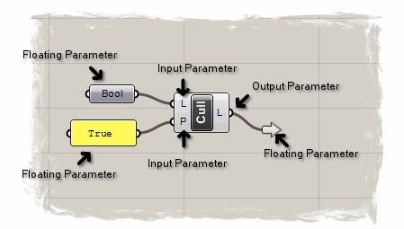
Grasshopper Parameters
Parameter Object Type:
Model
GsaAPI.Model
GSA Parameter Object Types
Parameter Object Type:
Node
GsaAPI.Node
GsaAPI.Axis
Grasshopper passes around copies
Point -> move = original + moved
Changes downstream should not effect original
GSA must provide some new Grasshopper Parameters (”Object Types”?)
GsaAPI.Model
GsaAPI.Node
GsaAPI.Bool6
GsaAPI.Member
GsaAPI.Bool6
GsaAPI.Offset
GsaAPI.Section
GsaAPI.Load
Some GSA Object Types can be mapped directly to existin GH Parameter, like Axis -> Plane
Parameter Object Type:
Bool6
GsaAPI.Bool6
What happens if we pass around GsaAPI.Model 15 times in a script?

Slide 5
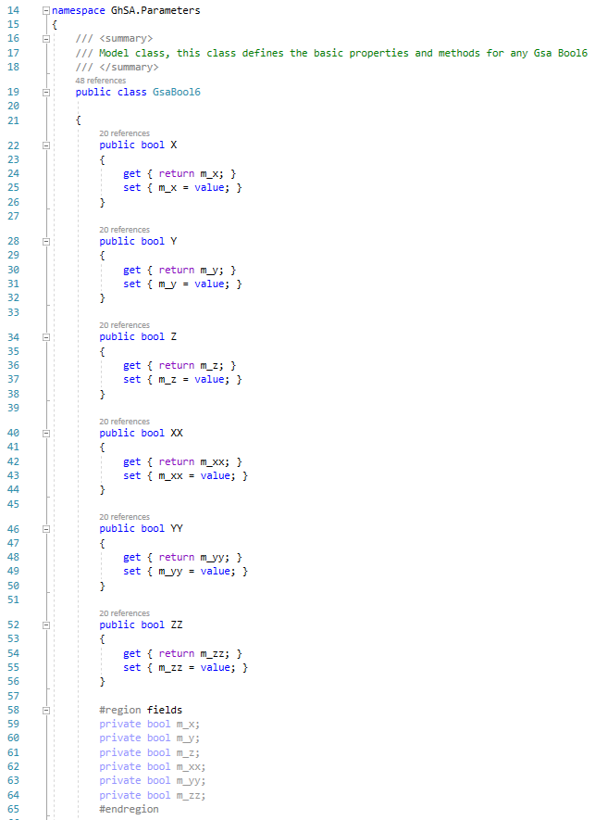
Grasshopper Parameters
GsaBool6
Parameter Object Type:
GsaBool6
bool GsaBool6.X
bool GsaBool6.Y
bool GsaBool6.Z
bool GsaBool6.XX
bool GsaBool6.YY
bool GsaBool6.ZZ

Slide 6
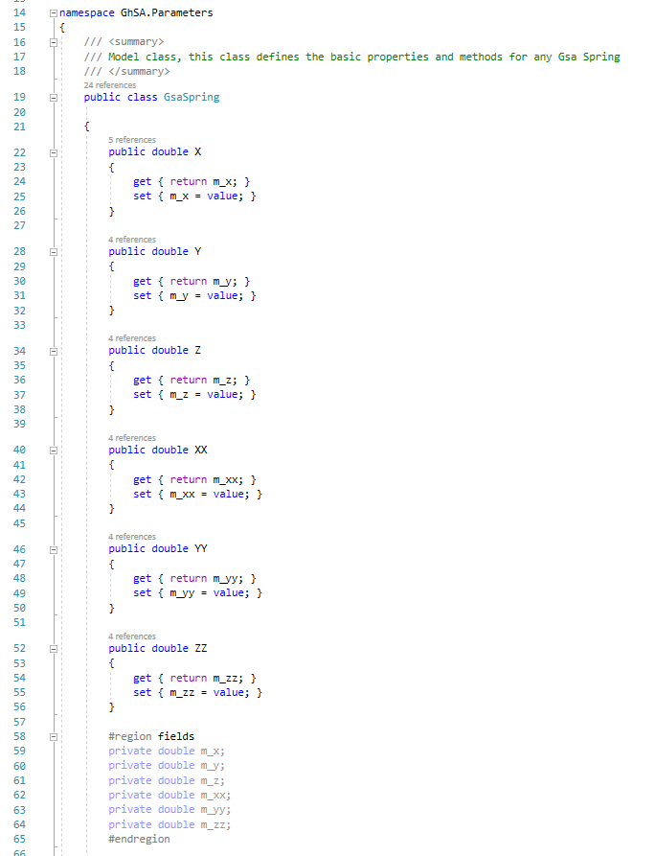
Grasshopper Parameters
GsaSpring
Parameter Object Type:
GsaSpring
double GsaSpring.X
double GsaSpring.Y
double GsaSpring.Z
double GsaSpring.XX
double GsaSpring.YY
double GsaSpring.ZZ

Slide 7
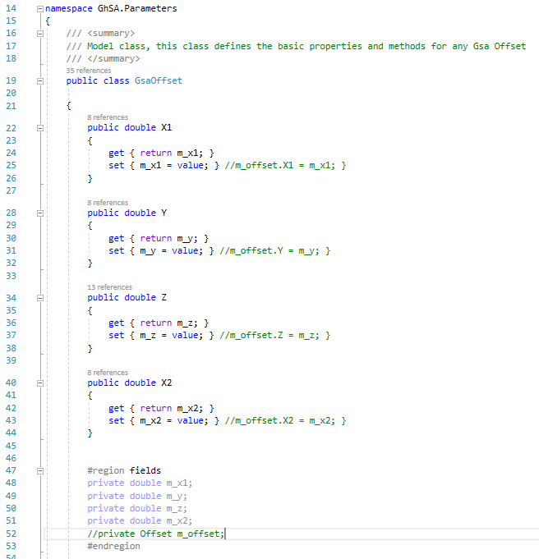
Grasshopper Parameters
GsaOffset
Parameter Object Type:
GsaOffset
double GsaOffset.X1
double GsaOffset.X2
double GsaOffset.Y
double GsaOffset.Z

Slide 8
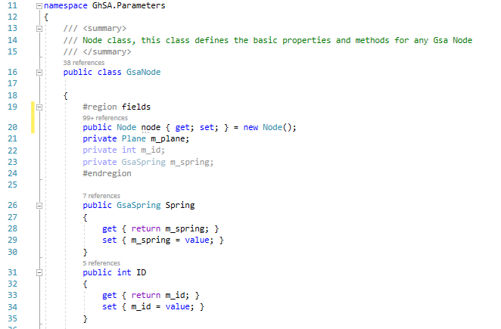
Grasshopper Parameters
GsaNode
Parameter Object Type:
GsaNode
GsaAPI.Node GsaNode.node
Rhino.Point3d GsaNode.Point
int GsaNode.ID
Rhino.Plane GsaNode.localAxis
GsaSpring GsaNode.Spring

Slide 9
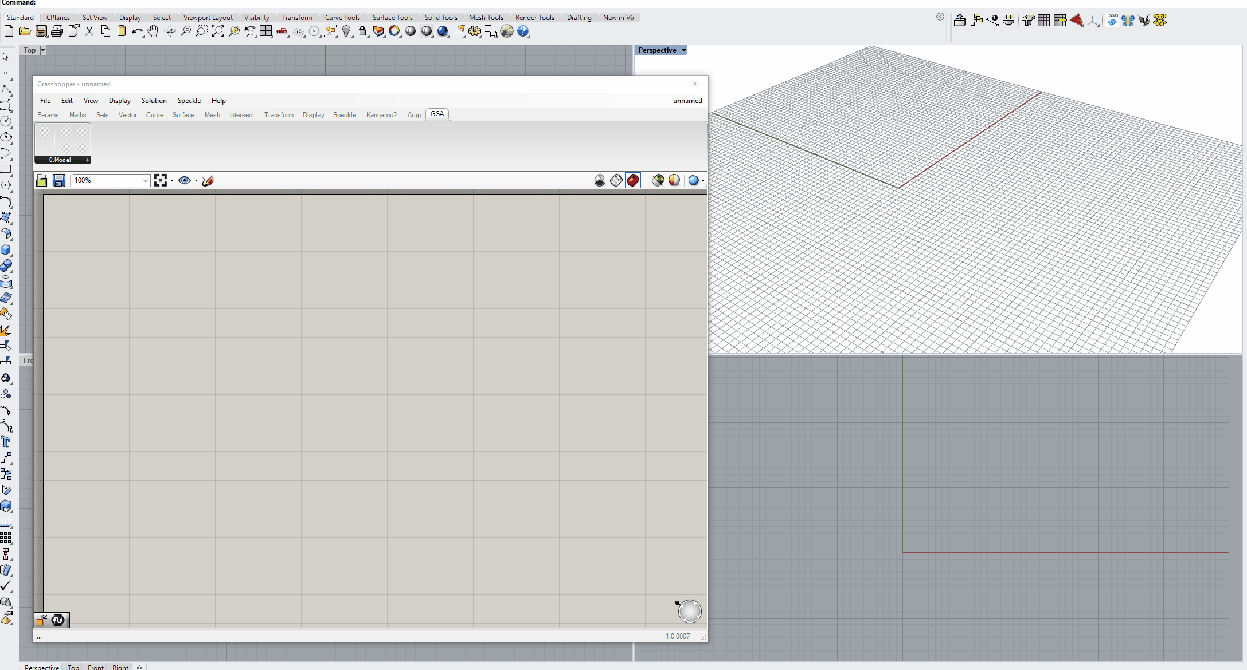
Parameter Object Type:
Node
GsaAPI.Node (Point3d)
GsaAPI.Axis (Plane)
Grasshopper Parameters
GSA Parameter: Gsa Node

Slide 10
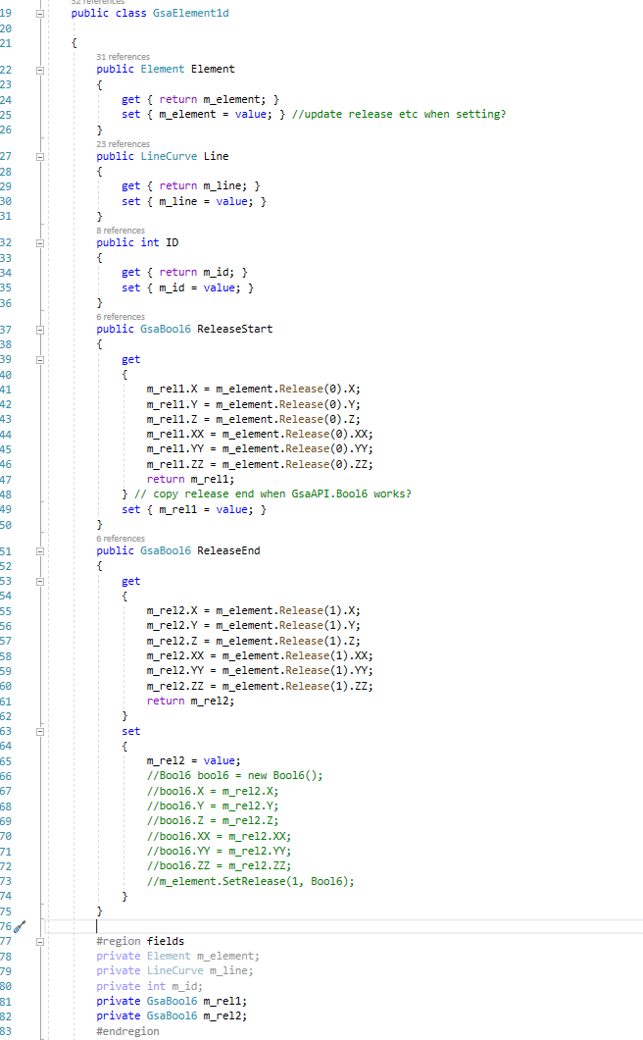
Grasshopper Parameters
GsaElement1d
Parameter Object Type:
GsaElement1d
GsaAPI.Element GsaElement1d.Element
Rhino.LineCurve GsaElement1d.Line
int GsaElement1d.ID
GsaBool6 GsaElement1d.ReleaseStart
GsaBool6 GsaElement1d.ReleaseEnd

Slide 11
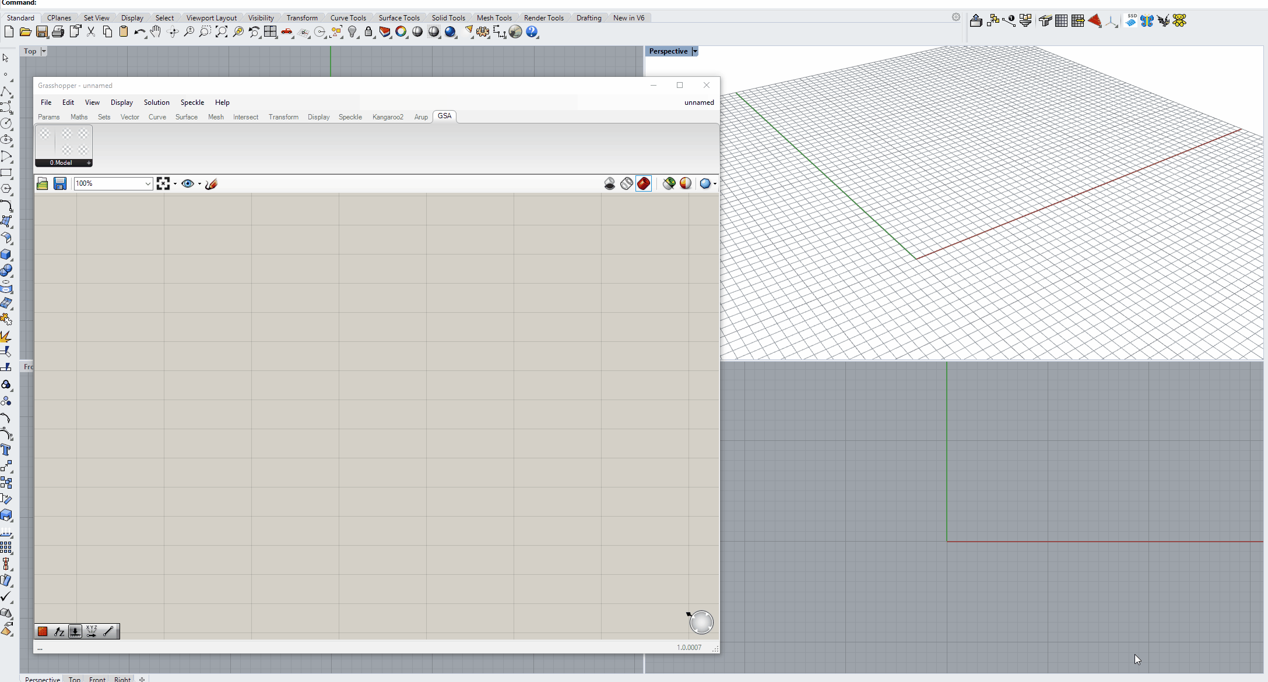
Parameter Object Type:
Element1D
GsaAPI.Element (Line)
Grasshopper Parameters
GSA Parameter: Gsa Element 1D

Slide 12
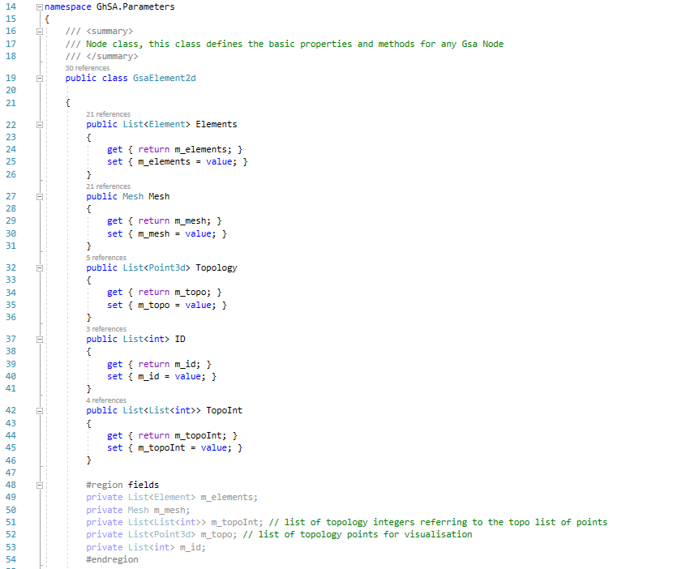
Grasshopper Parameters
GsaElement2d
Parameter Object Type:
GsaElement2d
List<GsaAPI.Element> GsaElement2d.Elements
Rhino.Mesh GsaElement2d.Mesh
List<Rhino.Point3d> GsaElement2d.Topology
List<int> GsaElement2d.ID
List<List<int>> GsaElement2d.TopoInt

Slide 13
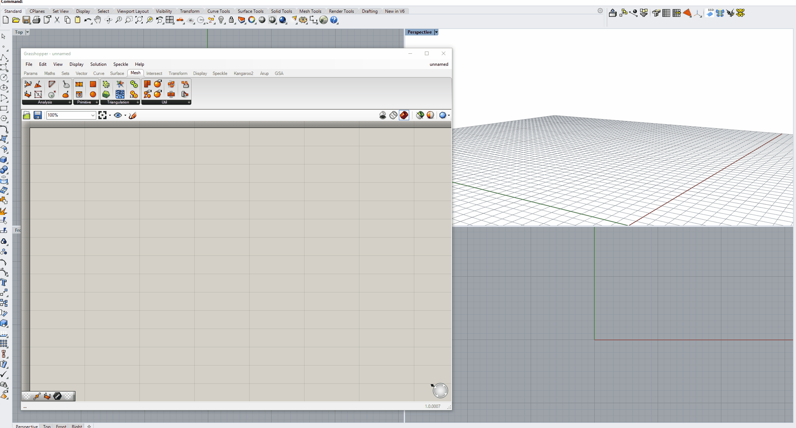
Parameter Object Type:
Element2D
List<GsaAPI.Element> (Mesh)
Grasshopper Parameters
GSA Parameter: Gsa Element 2D

Slide 14
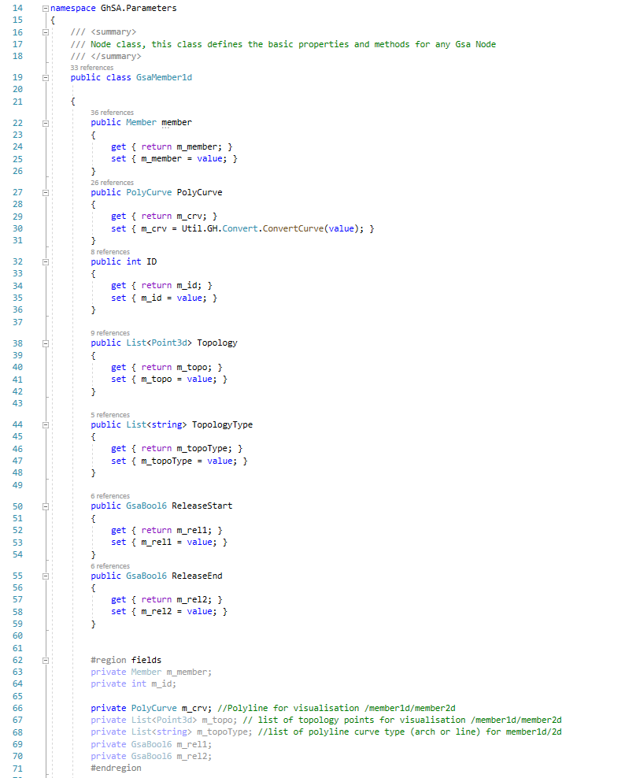
Grasshopper Parameters
GsaMember1d
Parameter Object Type:
GsaMember1d
GsaAPI.Member GsaMember1d.member
Rhino.PolyCurve GsaMember1d.PolyCurve
List<Rhino.Point3d> GsaMember1d.Topology
List<string> GsaMember1d.TopologyType
GsaBool6 GsaMember1d.ReleaseStart
GsaBool6 GsaMember1d.ReleaseEnd
To be added:
var (int / GsaSection) GsaMember1d.Section

Slide 15
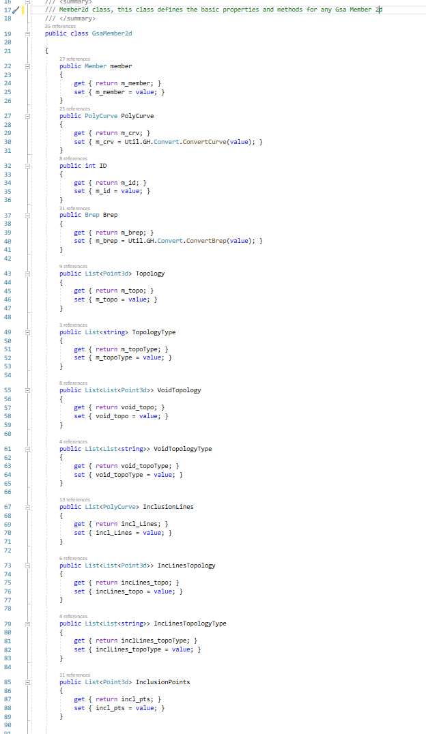
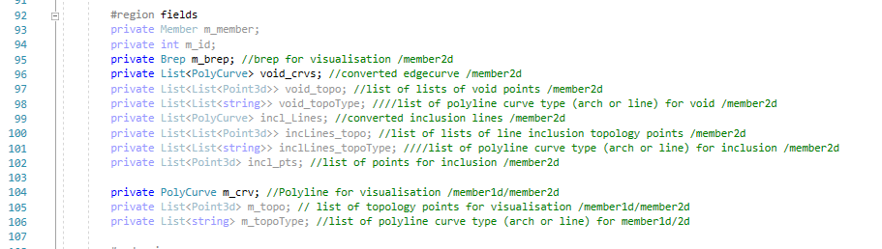
Grasshopper Parameters
GsaMember2d
Parameter Object Type:
GsaMember2d
GsaAPI.Member GsaMember2d.member
Rhino.Brep GsaMember2d.Brep
List<Rhino.Point3d> GsaMember2d.Topology
List<string> GsaMember2d.TopologyType
List<List< Rhino.Point3d >> GsaMember2d.VoidTopology
List<List<string>> GsaMember2d.VoidTopologyType
List<Rhino.PolyCurve> GsaMember2d.InlusionLines
List<List< Rhino.Point3d >> GsaMember2d.IncLinesTopology
List<List<string>> GsaMember2d. IncLinesTopologyType
List<Rhino.Point3d> GsaMember2d.InclusionPoints
To be added:
var (int / GsaSection) GsaMember1d.Section

Slide 16
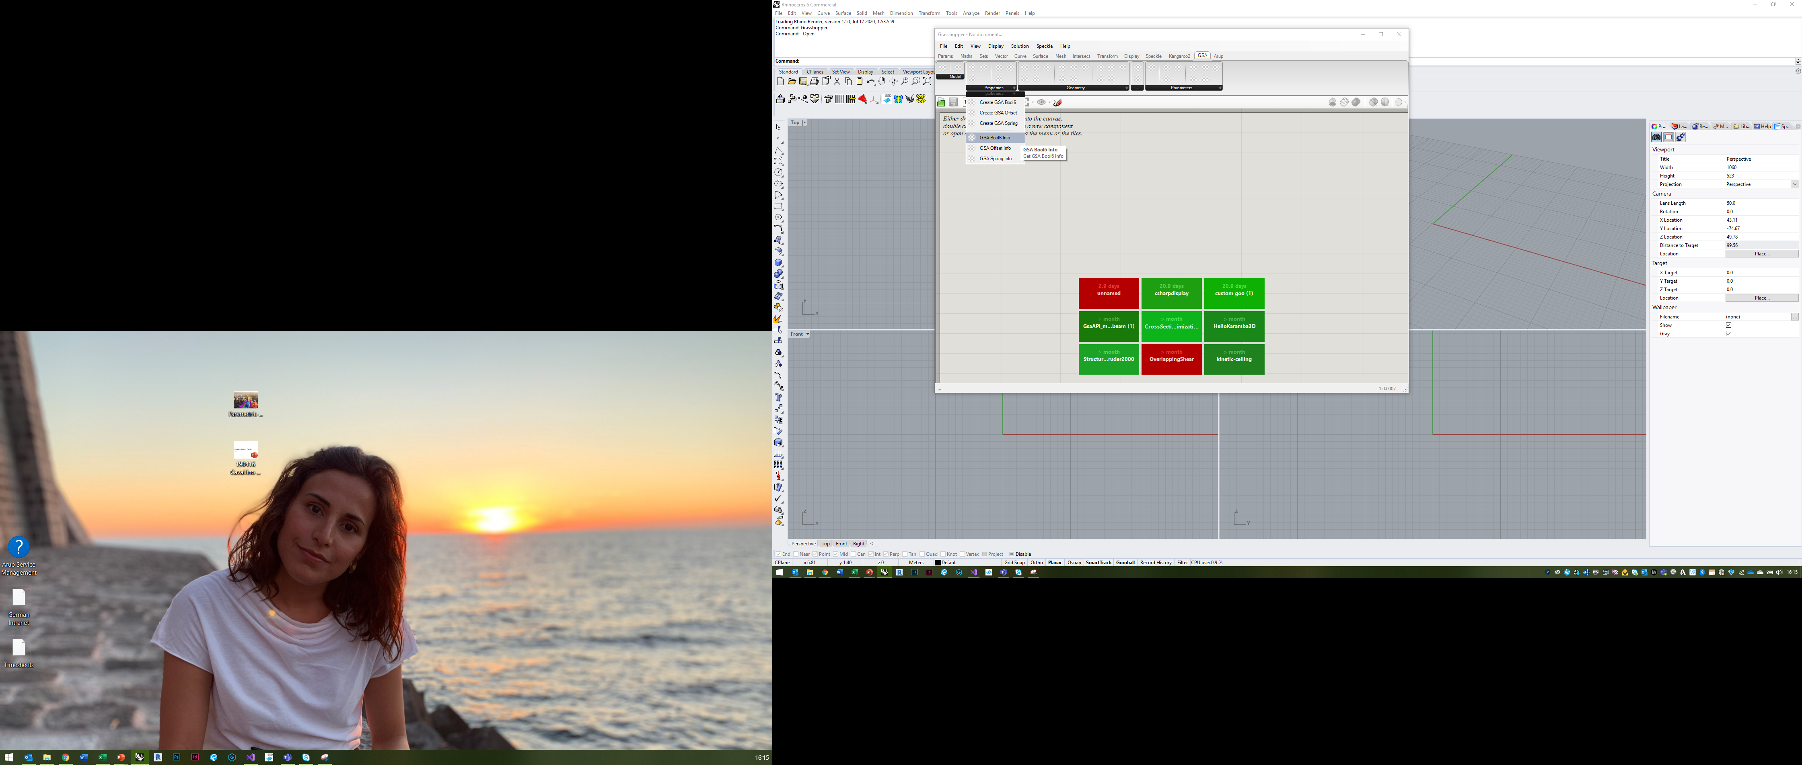
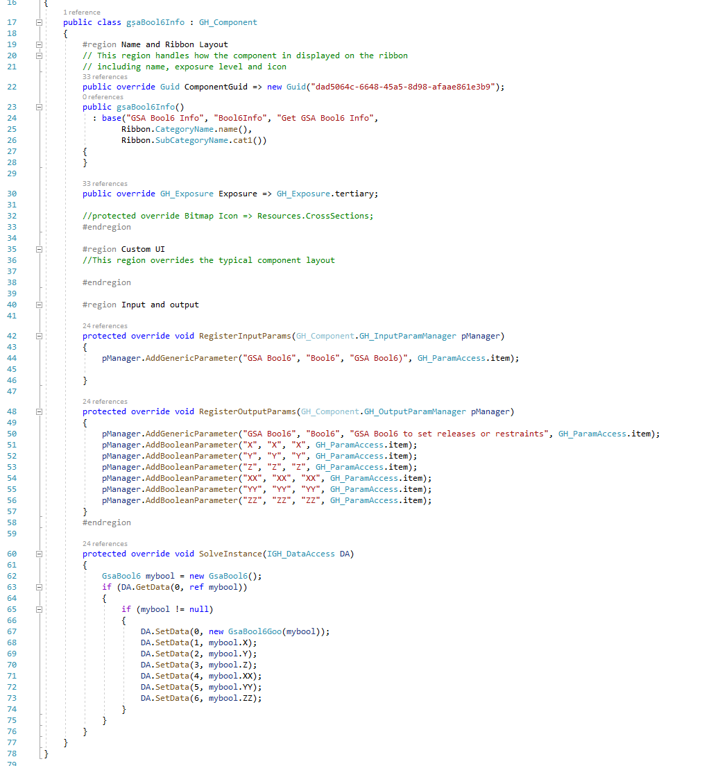
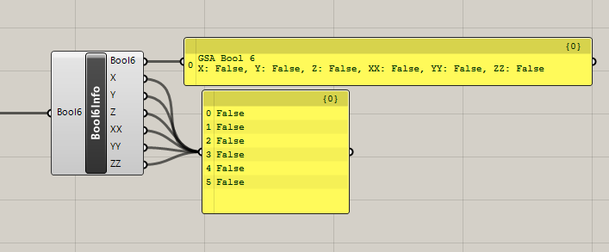
Components
Simple example: Bool6 info
Unique GUID
Name, Nickname and description
Plugin name and Subcategory
should call Ribbon helper class
Position on Ribbon dropdown
Output as Goo-type
Output each individual setting

Slide 17
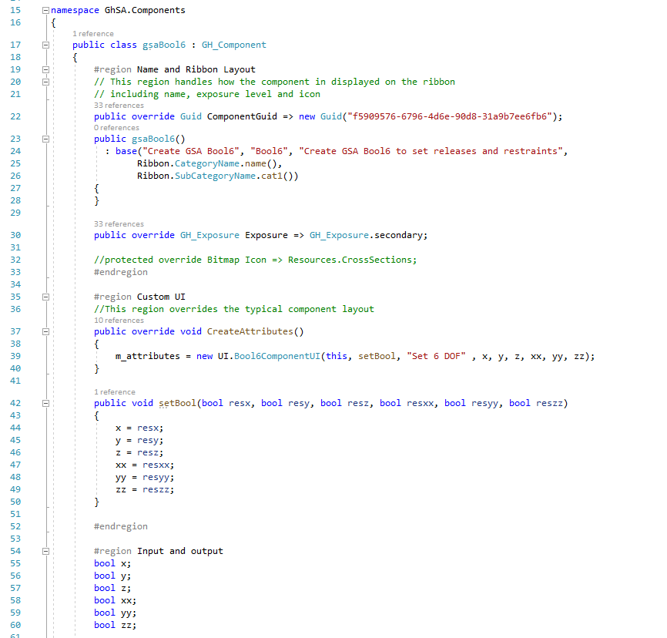
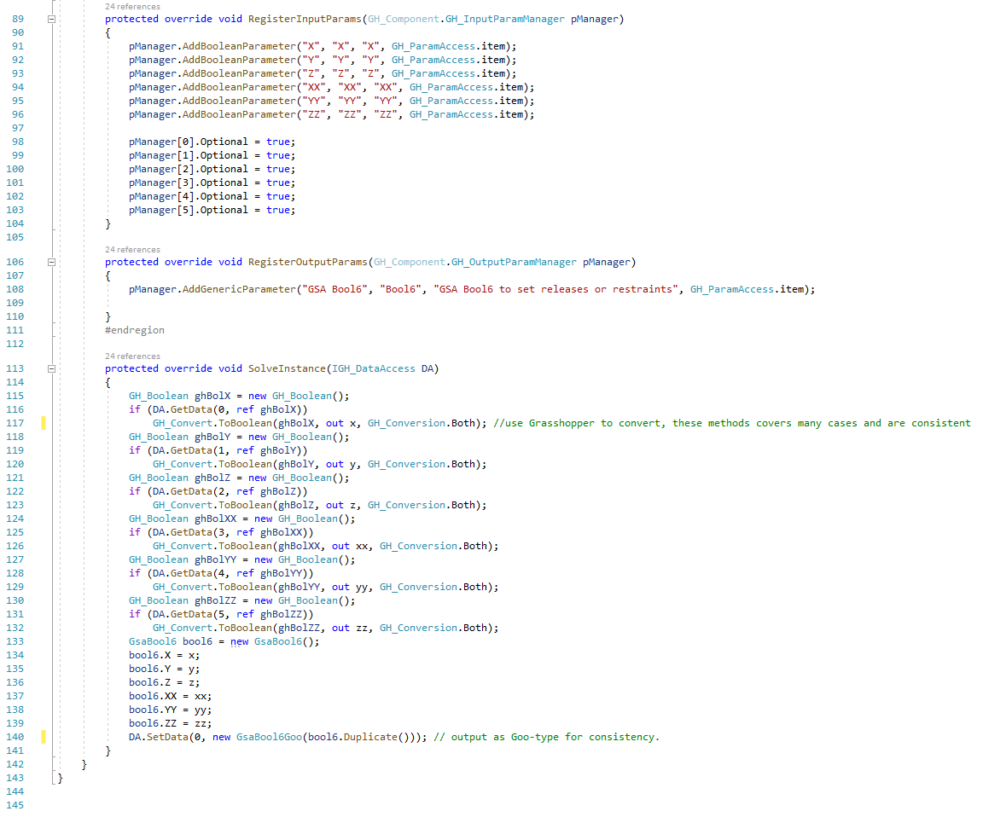
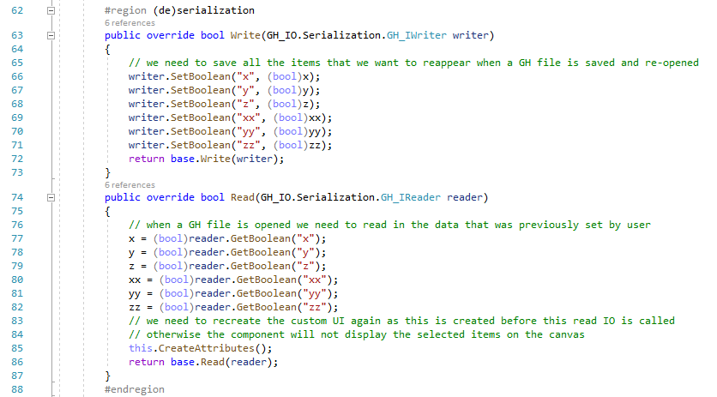
Components
Custom GUI example: Bool6 create
As simple component
To create custom UI we must override “CreateAttributes”
Call Bool6CompomentUI function with an action/function (“setBool”) that can set this components variables
Set of parameters outside of solve-instance that can be set by UI
We need to add this (de)serialisation section to be able to save the user-input to made with the custom UI interface, otherwise the component will reset to default settings when a saved grasshopper file is reopened

Slide 18
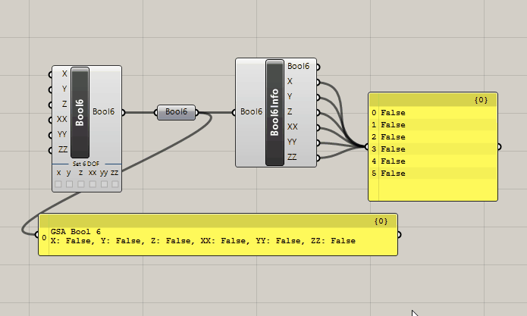
Components
Custom GUI example: Bool6 create
As simple component
Use Grasshopper to convert whenever possible; this means fx that a Boolean input can also be 0 or 1, but more expanded for geometry types

Slide 20
Use cases
Boolean 6
Parameter Object Type:
Node
GsaAPI.Node
GsaAPI.Axis
x
y
Create: Nodes
z
xx
Bool6
yy
Geometry:
Point -> Position
Plane -> Location axis
MetaData:
Restraints: bool6
Spring property (int or spring object?)
Mass property
Damper property
Local element size
Other: name, colour, connected elements, axis property – necessary?
Support component inputs:
Point(s)
Plane(s) – must be passed around as Axis until model assembly?
Bool6 list to override UI input?
Spring(s) – must be passed around as SpringProp until model assembly?
Modify Node component:
Set/Change mass, damper, local element size, name, colour, axis
zz
Set all
x
y
z
xx
yy
zz
Parameter Object Type:
Bool6
GsaAPI.Bool6
Pt
Support
Pl
Node
Res
Spr
Restraints
Free
Pin
Fix
x
y
z
xx
yy
zz

Slide 21
Use cases
Boolean 6
Parameter Object Type:
Member
GsaAPI.Member
List<Node>
Prop
Material
x
y
Create: 1D Member
z
xx
Bool6
yy
zz
Geometry:
Line, Arc, Polyline – alternative also Curve with automatic conversion to lines and arcs?
Topology list to be passed around as Points until model assembly?
MetaData:
Property (int or property object?)
MemberType (list input, dropdown UI, ??)
End releases (2x bool6)
Offset – own parameter object type
Orientation (node (int or node object type) and angle(double))
MeshSize (double)
Mesh with others (bool)
Create Member1D component inputs:
Curve
Property
MemberType
Releases
Offset
Modify Member1D component:
Set/Change: Inclusion points, Mesh with others, MeshSize, Name, Colour, Orientation
Set all
x
y
z
xx
yy
zz
Parameter Object Type:
Offset
GsaAPI.Offset
X1
Offset
X2
Offset
Y
Z
M1D
Modify Member 1D
M1D
Prop
Prop
Typ
Typ
Crv
M1D
Mem1D
Rel1
Rel1
Prop
Rel2
Rel2
Type
Offs
Offs
Generic 1D
Releases
OriA
OriA
S
x
y
z
xx
yy
zz
OriN
OriN
E
x
y
z
xx
yy
zz
MsO
MsO
Simple create
MSz
MSz
Extended modify
Crv
Member 1D
Crv
Modify Member 1D
Crv
Member 1D
Prop
Prop
Prop
Typ
Mem1D
Typ
Mem1D
Typ
Mem1D
Rel1
Rel1
Rel
Rel2
Rel2
Offs
Offs
Offs
Layer
Analysis
Design
Simple option
Type | Generic 1D
Releases
Releases
S
x
y
z
xx
yy
zz
S
x
y
z
xx
yy
zz
E
x
y
z
xx
yy
zz
Another option
E
x
y
z
xx
yy
zz
Comined analysis/design option

Slide 22
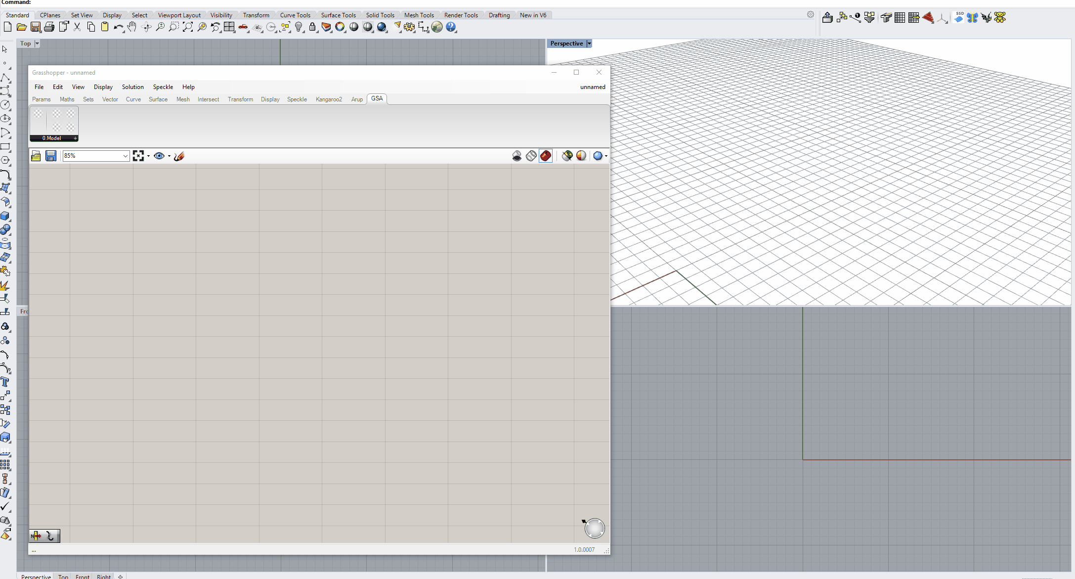
Use cases
Create: Open model

Slide 23
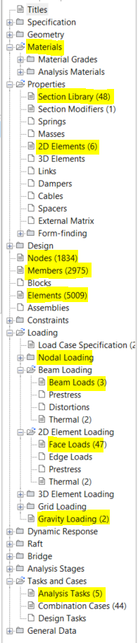
Use cases
Create // Modify // Results
The components have been developed to sit in six categories, both inheriting the way GSA is structured and supporting the natural workflow of creating an FE model:
Geometry (create/initialise model)
New model from geometry (elements, members, supports, offsets, releases)
Open exsting GSA model
Properties: Materials and Sections
Loads
Analysis
Results
Output (save file / open in GSA, export to other program, send to speckle)

Slide 24
Workflow
6 categories
Open
Material
Profile
Gravity
Node
Offset
Add
Sec 1D
Beam
Face
Support
Sec 2D
1 Geometry
2 Properties
3 Loads
Tasks
Combinations
Analyse
4 Analyse
Beam
Face
Save
Speckle
5 Results
6 Output

Slide 25
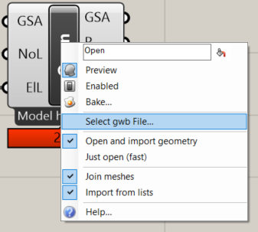
Components
1 Geometry: Open component
Open
Offset
Add
Support
1 Geometry
The right-click menu for options
”Open” component:
Right click to get options menu
Select gwb file through windows explorer (handy for new GH users)
Open and import geometry
Just open
Settings
Join meshes (GSA works with single faces, use build-in join routine to combine faces into connected meshes)
Import from lists – let you use the known text filtering syntax (”PB1 to PB4” etc)
Message displayed at bottom of component with information about the model:
Empty model // Model not analysed // Model has results

Slide 26
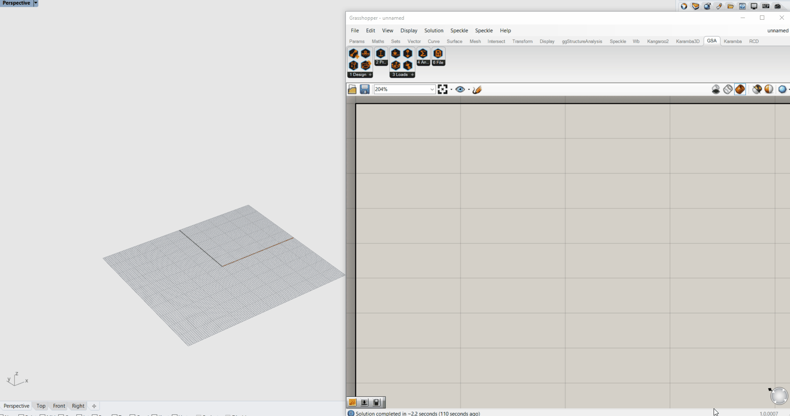
Components
1 Geometry: Open component

Slide 27
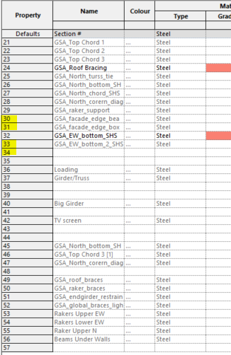
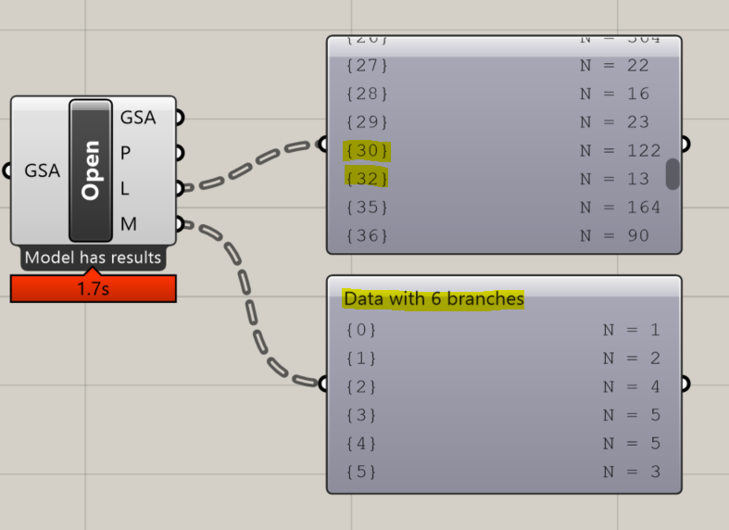
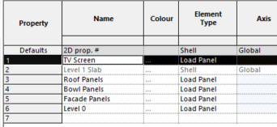
Components
1 Geometry: Open component
Open
Offset
Add
Support
1 Design
GH Data tree output (0-based index)
”Open” component:
Importing geometry
Points not imported by default (slows things down and is generally not that useful)
1D analysis elements imported as lines
2D analysis elements imported as mesh and optionally joined
Geometry is sorted according to their properties
All elements of property X will be in branch (X-1) in grasshopper
GSA Section Library (1-based)
GSA 2D Elements (1-based)

Slide 28
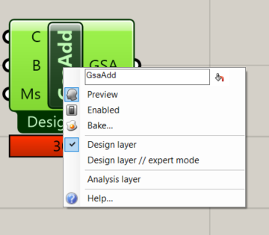
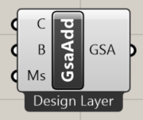
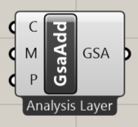
Components
1 Geometry: Add component
Open
Offset
Add
Support
1 Design
The right-click menu for options
The two main component flavours
”Add” component:
The main design component – users can generate all the required geometry from this single component. Must be able to handle simple tasks, explicit/detailed stuff and write to both analysis and design layer.
Right click to get menu options:
Design layer (default, simple inputs for curves, breps/surfaces and mesh size)
Design layer // expert mode (all settings for members become available)
Analysis layer (three simple inputs for analysis: nodes, lines, meshes)

Slide 29
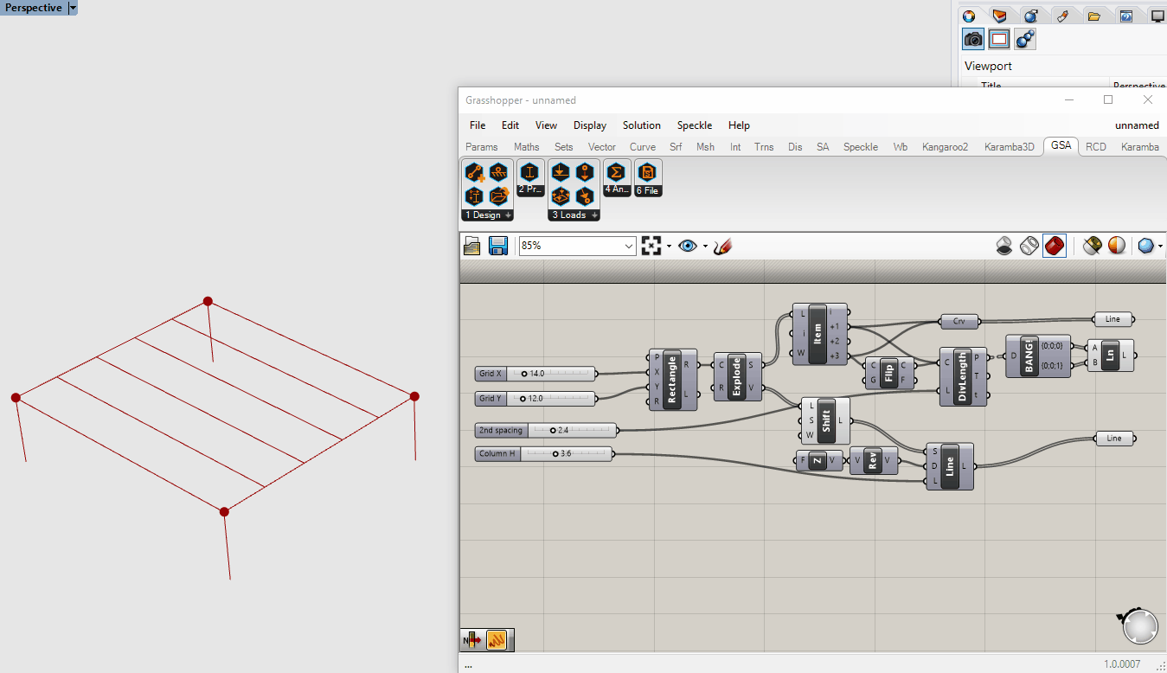
Components
1 Geometry: Add component / 1D member properties

Slide 30
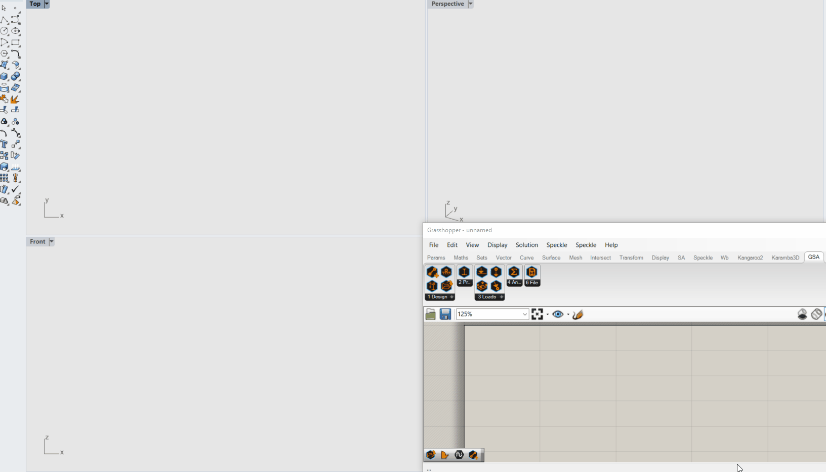
Components
1 Geometry: Add component / 2D member meshing

Slide 31
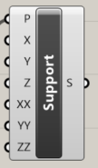
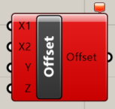
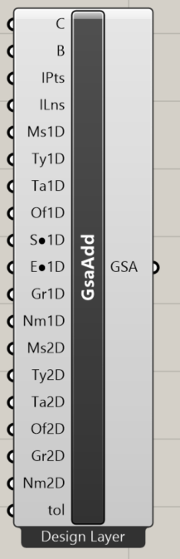
Components
1 Geometry: Add component / Expert mode
Open
Curves/Lines
Brep/surfaces
Include points; to include in mesh
Include lines; to include in mesh
Mesh size 1D members
Type 1D members
Analysis type 1D members
Offset
Start Member End Condition
End Member End Condition
Group 1D
Name 1D
Mesh size 2D members
Type 2D members
Analysis type 2D members
Offset
Group 2D
Name 2D
Tolerance
Offset
Add
Offset not working atm due to missing API function/bug
Support
Support not working atm due to API bug
1 Design
”Add” component:
Creates a new empty GSA model to write to
Members/elements with properties corrosponding to the input branch (similar to the Open component methodology)
Nurbs automatically converted to polygons with a preset convertion method (using Rhino Convert Method)
When topology is created nodes are being checked for duplicates with a set tolerance distance against all existing model nodes
Members/elements/nodes are added to the model
For both Design Layer options, the last step is to create elements from members
Output is a GSA model as it is not possible to create elements/members referring to node coordinates but to topology. A single output model was chosen instead
Design Layer // Expert mode

Slide 32
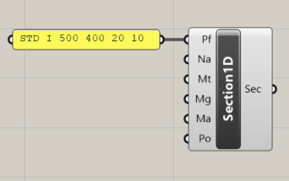
Components
2 Properties: Section1D component
Material
Profile
Sec 1D
Sec 2D
2 Properties
Section1D component
”Section1D” component:
Creates a Section from profile input
Default material (steel)
”Profile” component (to be developed):
Method to look up catalogue sections
Possibility to input drawn closed curve
Custom profile copying the logic of the text input (e.g. Something that automatically writes the text string ”STD I 500 400 20 10”.

Slide 33
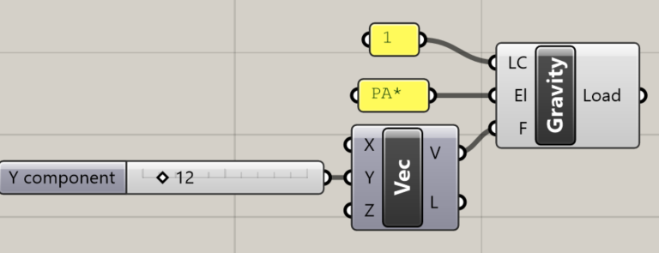
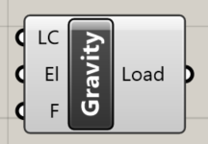
Components
3 Loads: Gravity component
Gravity
Node
Beam
Face
Gravity load default
3 Loads
Gravity load with odd inputs
”Gravity” component:
Creates a new GravityLoad
Default to z = -1 factor
Can be altered with the known GSA-like input methods

Slide 34
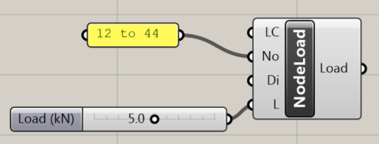
Components
3 Loads: NodeLoad component
Gravity
Node
Beam
Face
NodeLoad component
3 Loads
”NodeLoad” component:
Creates a new NodeLoad from a nodelist and load value
Default direction z

Slide 35
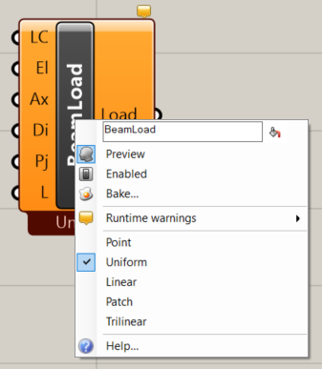
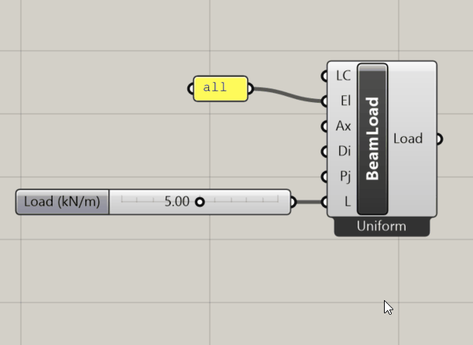
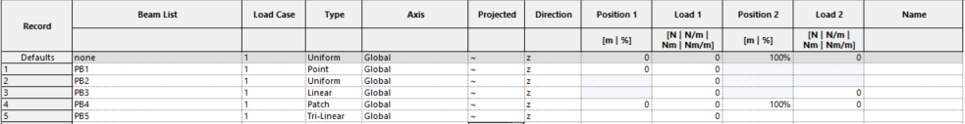
Components
3 Loads: BeamLoad component
Gravity
Node
Beam
Face
3 Loads
BeamLoad right-click optoins
BeamLoad changing load type
”BeamLoad” component:
Right-click menu to toggle between load types: Point, Uniform, Linear, Patch or Triliniar
Static inputs for load case, element list, axis, direction and projection (with defaults)
Input adapts to the selected load type as known from GSA:

Slide 36
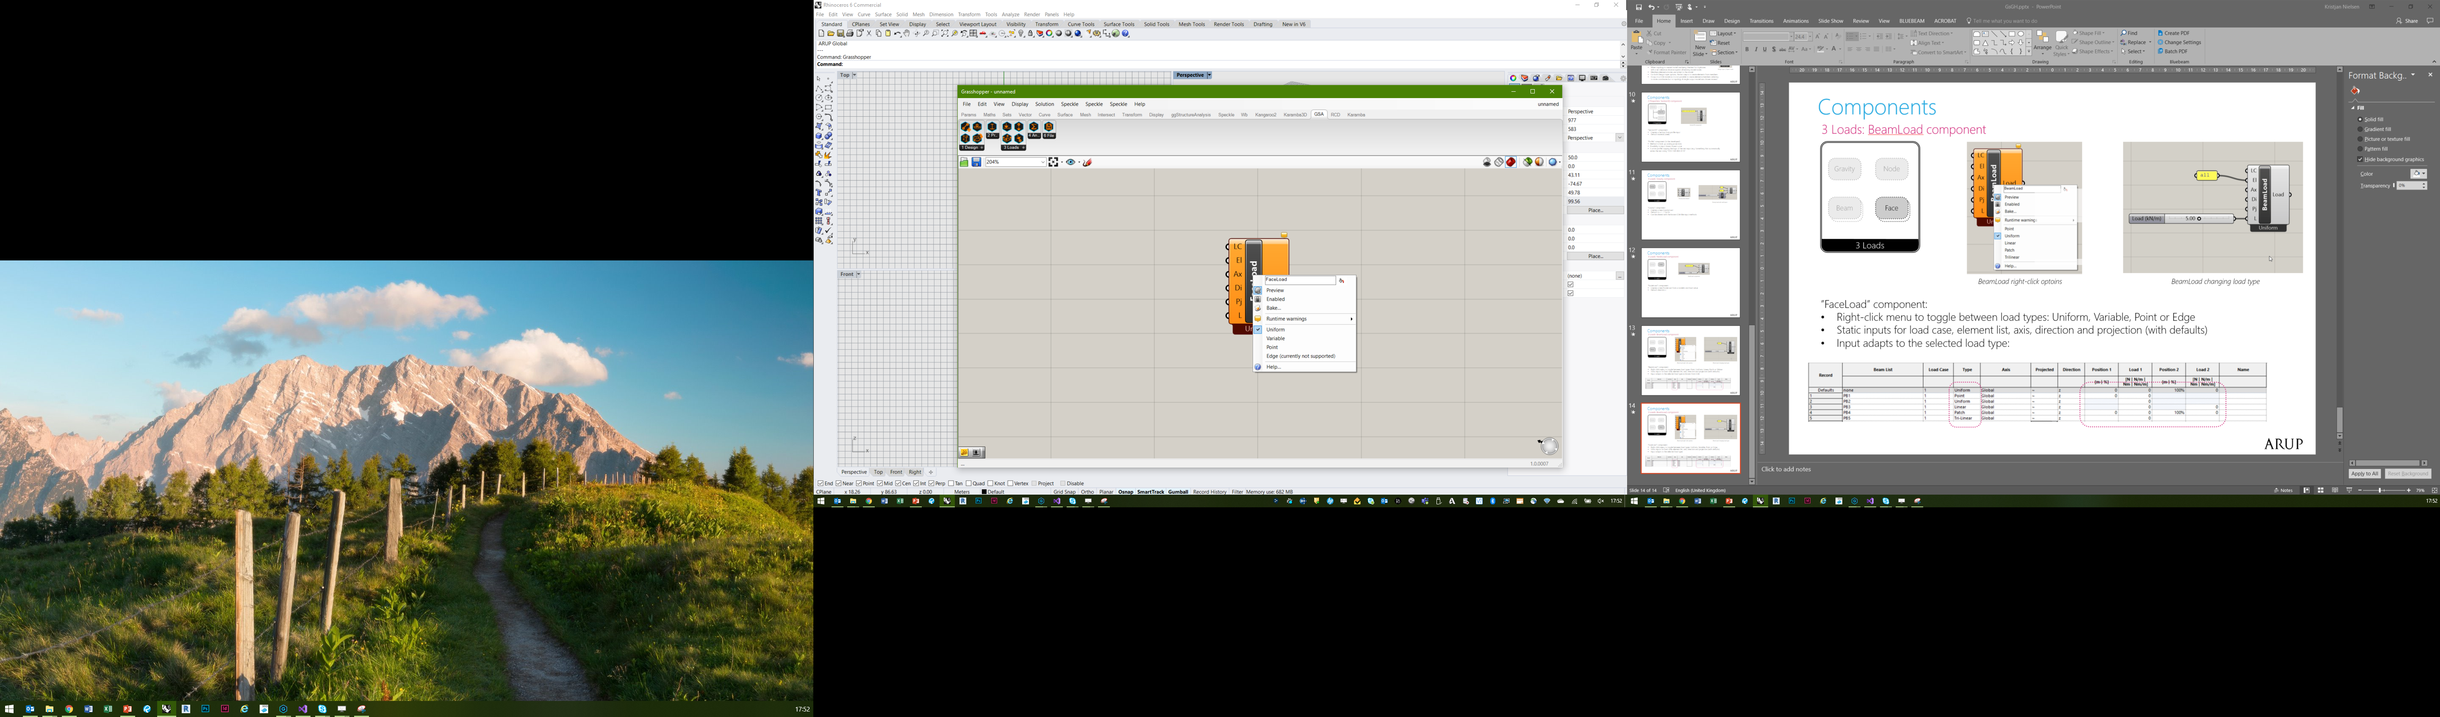
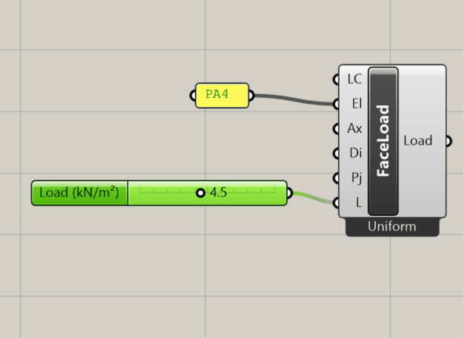
Components
3 Loads: FaceLoad component
Gravity
Node
Beam
Face
3 Loads
FaceLoad right-click optoins
FaceLoad changing load type
”FaceLoad” component:
Right-click menu to toggle between load types: Uniform, Variable, Point or Edge
Static inputs for load case, element list, axis, direction and projection (with defaults)
Input adapts to the selected load type:

Slide 37
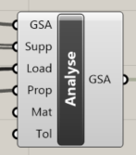
Components
4 Analysis: Analyse component
Tasks
Combinations
Analyse
4 Analyse
Analysis component
”Analyse” component:
Will/should be able to merge model inputs, so that users can append to existing models
Takes all the inputs from categories 1, 2 and 3 and assembles a model
Different analysis methods (and their settings) still to be developed/implimented
Potential to have option to ”send to GsaCloud” for analysis
Task & combinations (still to be developed)

Slide 38
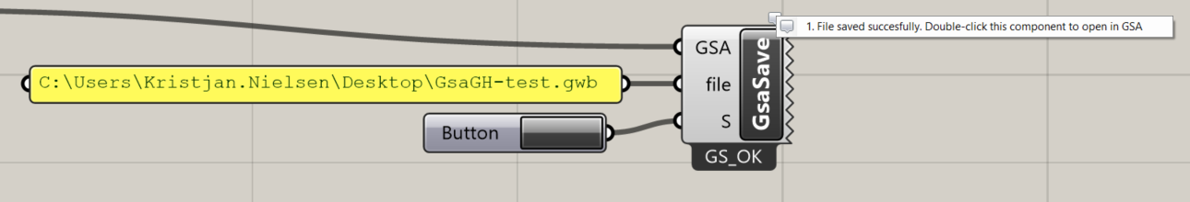
Components
6 File: Save component
Save
Speckle
6 Output
Save component – double-click to open file in GSA!
”Save” component:
Save if no input to file
Save as if file has input
Double-click component to automatically open the file in GSA
Spekle (still to be developed) – plug GSA output directly to speckle

Slide 39
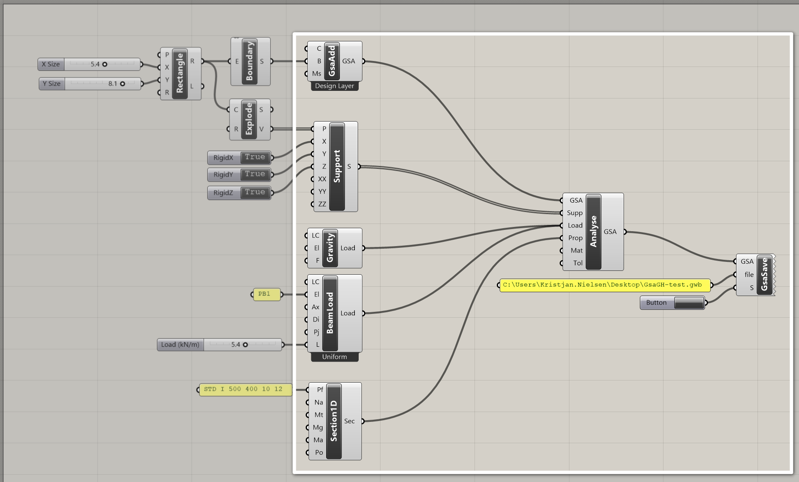
GsaGH current component overview

Slide 40
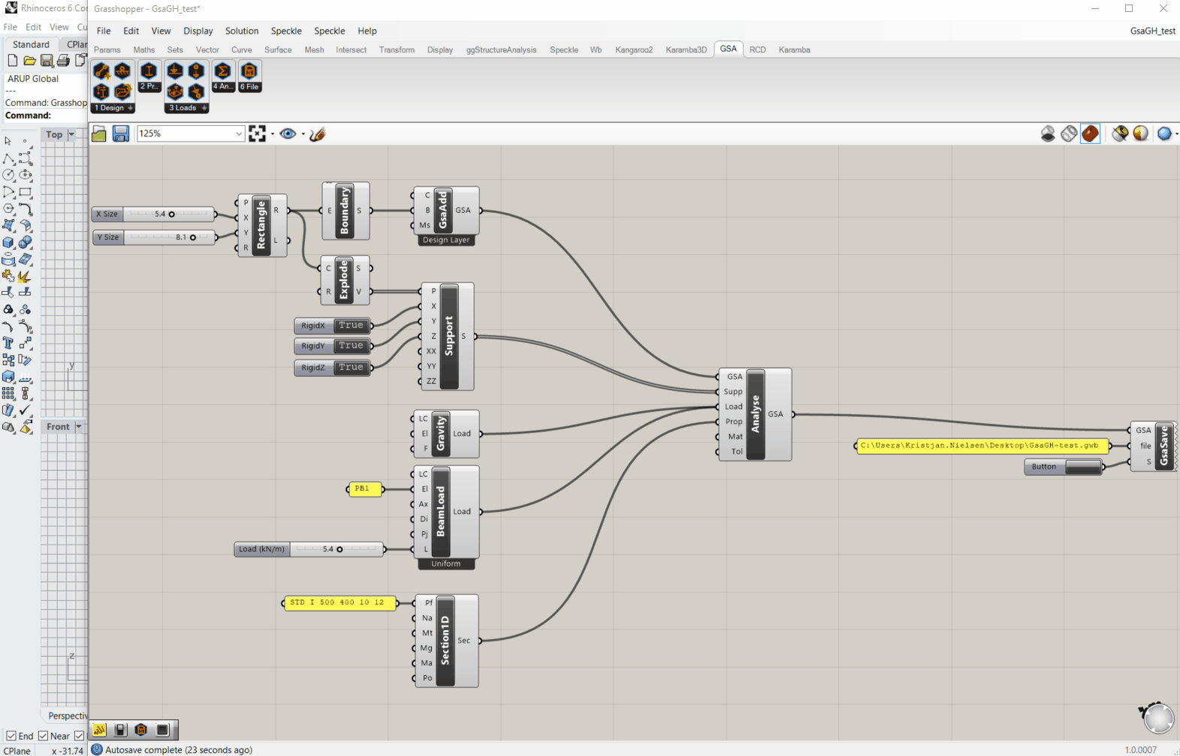
GsaGH Components test-run

Slide 41
Next steps
GsaGH ideas braindump
Short term
Analysis
Implement setting up analysis tasks
Implement ability to run analysis
Results
Extract numbers
Continue Alpha-testing / bug fixes / implement new GsaAPI updates
Review everything (code, architecture, UI)
Get funding!
Long term
Analysis
Support GsaCloud
Find a way to run analysis locally on multiple cores without affecting Rhino/Grasshopper performance while running
Load combinations (need a proper UI pop-up is my guess)
Develop/design better component UI
Speckle support (open/save)

